Slide 1



PROJECT TITLE
BANK LOAN APPROVAL
PANKAJ 20CSU075
DINESH 20CSU191
JYOTROOP 20CSU207
TUSHAR 20CSU231
CASE
STUDY

Slide 2

Problem Description
Bank now-a-days want to ensure that they get their money back from whose they loan the amount to. It is becoming increasingly common these days for customers to default Bank given loans and as recipients the customers do not have enough so that the bank may take possession. To avoid such a problem, banks are now depending on the patterns to determine the can be defaulters.
Such a problem arises when the loan approving managers at the banks are not correctly able to identify the candidates correctly that may give approval correctly. This dataset contains credit information of applicants of loans. Banks wants to leverage this data to determine, and create models to help in deciding who to accept/refuse for a loan.

Slide 3

BUSINESS
GOAL OBJECTIVES
Key Points
To leverage the predictive capability of understanding of past customer’s profile to minimize the risk of future loan defaults.
Banker managers would be able to create a distinction among applicants based on who are more likely to repay the loan amount based on this predictive model and hence will be a better customer to the bank.

Slide 4
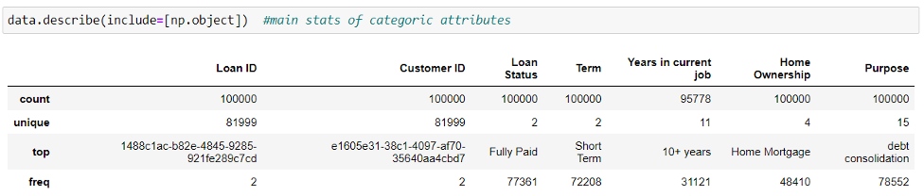
DATA DESCRIPTION (Part 1)
Monthly Debt : monthly debt of the customer
Years of Credit History : for how many years the applicant has been using credit
Months since last delinquent : last time when the applicant was unable to make the installment
Number of Open Accounts : number of open bank accounts
Number of Credit Problems : if faced any credit problem in the past
Current Credit Balance : current credit balance that needs to be settled.
Maximum Open Credit : maximum balance of the credit of the applicant
Bankruptcies : if filed for any bankruptcy over the years

Slide 5
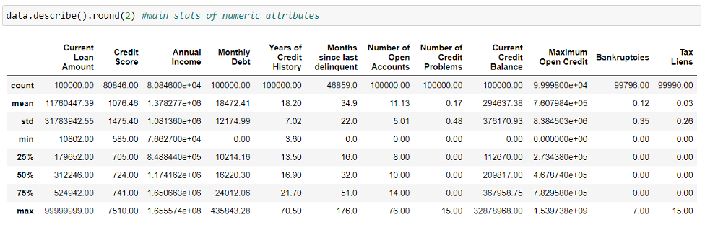
DATA DESCRIPTION (Part 2)
Loan ID : Applicant ID of the customer
Customer ID : customer’s bank id
Current Loan Amount : loan amount undertaken by the customer
Term : loan applied whether for short term or long term
Credit Score : determines the paying back credibility of a customer
Annual Income : depicts the annual income of the applicant
Years in current job : number of years worked in the current job
Home Ownership : who has the ownership of the house resided by the applicant
Purpose : purpose of loan
Tax Liens : if any tax lien issued adoption of the best marketing strategies by Walmart, certain issues arise in the function of the company. A wide difference is

Slide 6

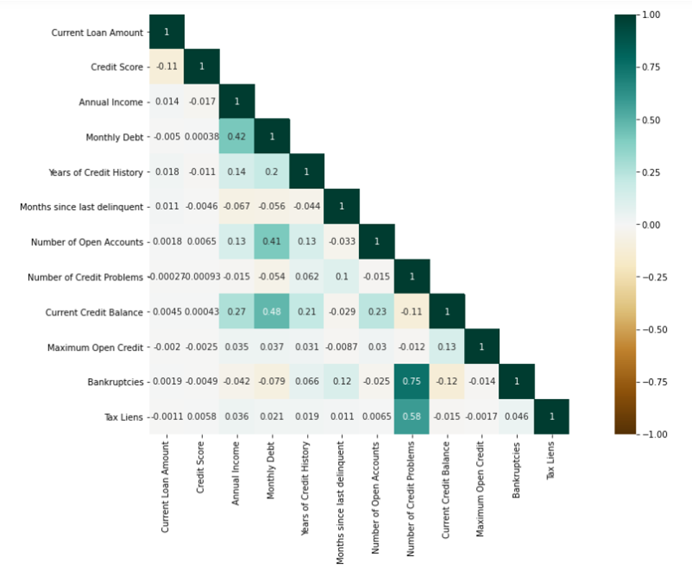
CORRELATION BETWEEN PARAMETERS

Slide 7


DATA CLEANING
In this moduwithle, duplicates were identified and dropped followed with replacing of null values their respective means.
ARCHITECTURE
(DIAGRAMMATIC)
Correlation between various features of data were identified and distribution or relation between them was visualized in the forms of plots and charts.
DATA VISUALIZATION
•The dataset is divided into training and testing for the model fitting.
•Models having greater accuracy are selected and considered for implementation.
MACHINE
LEARNING IMPLEMENTATION

Slide 8
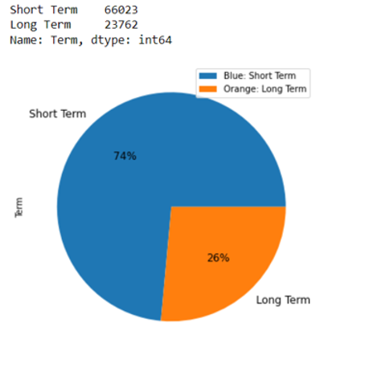
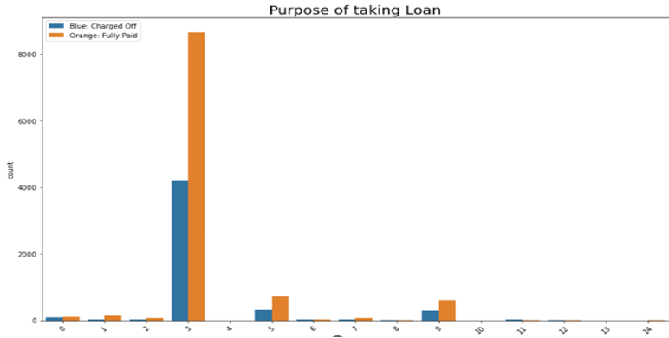
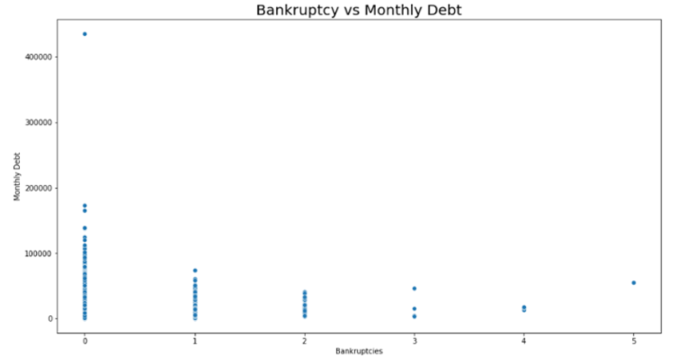
DATA VISUALIZATION
3
1
Count of purpose of taking loan
Percentage
of
loan term
2
Distribution of Bankruptcy
Vs
Monthly Debt

Slide 9

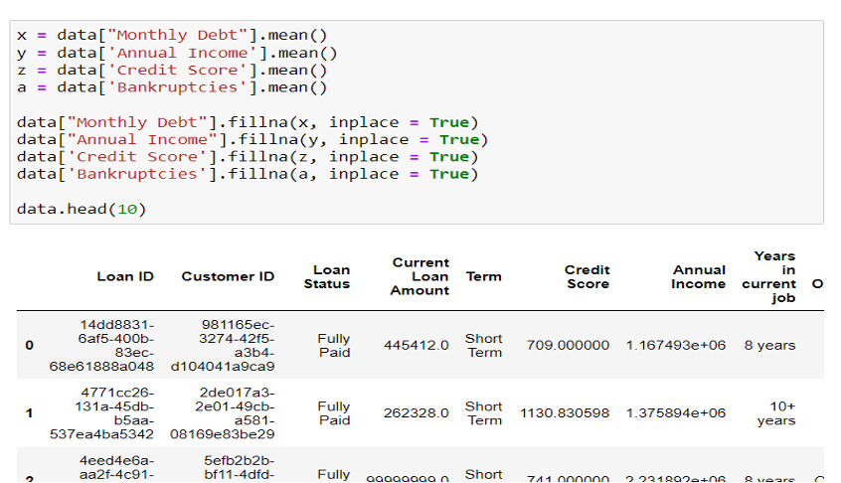
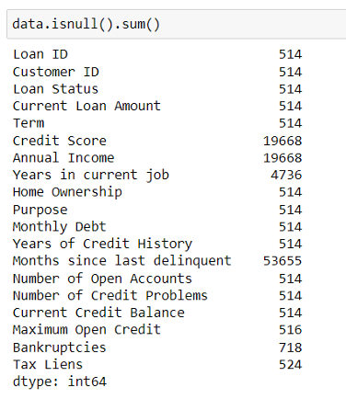
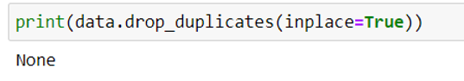
DATA WRANGLING
ACTIVITIES PERFORMED
Filling Null Values
Identifying and dropping duplicates

Slide 10
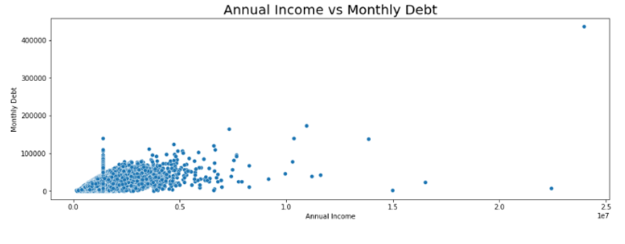
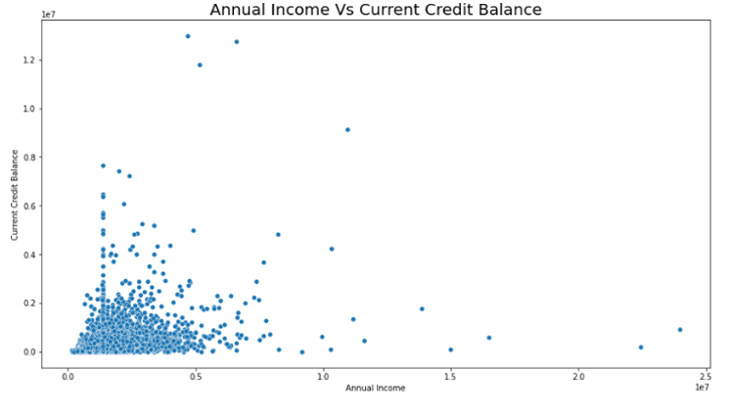
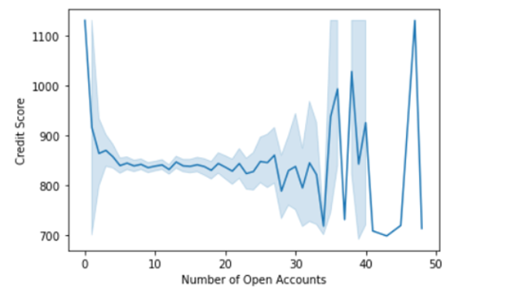
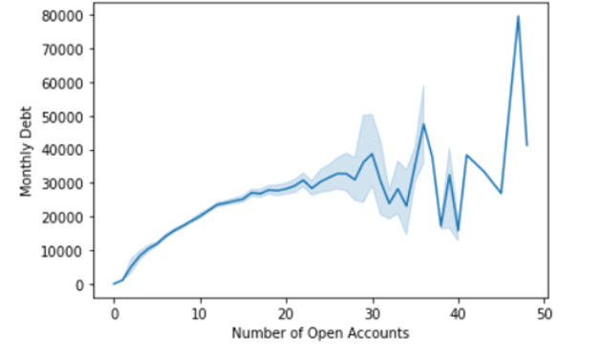
DATA VISUALIZATION
Distribution of
Annual Income
Vs
Current
Credit Balance
Distribution of Annual Income Vs Monthly Debt
Distribution of
Number of
Open Accounts
Vs Monthly Debt
Distribution of Number of
Open Accounts Vs Monthly Debt

Slide 11
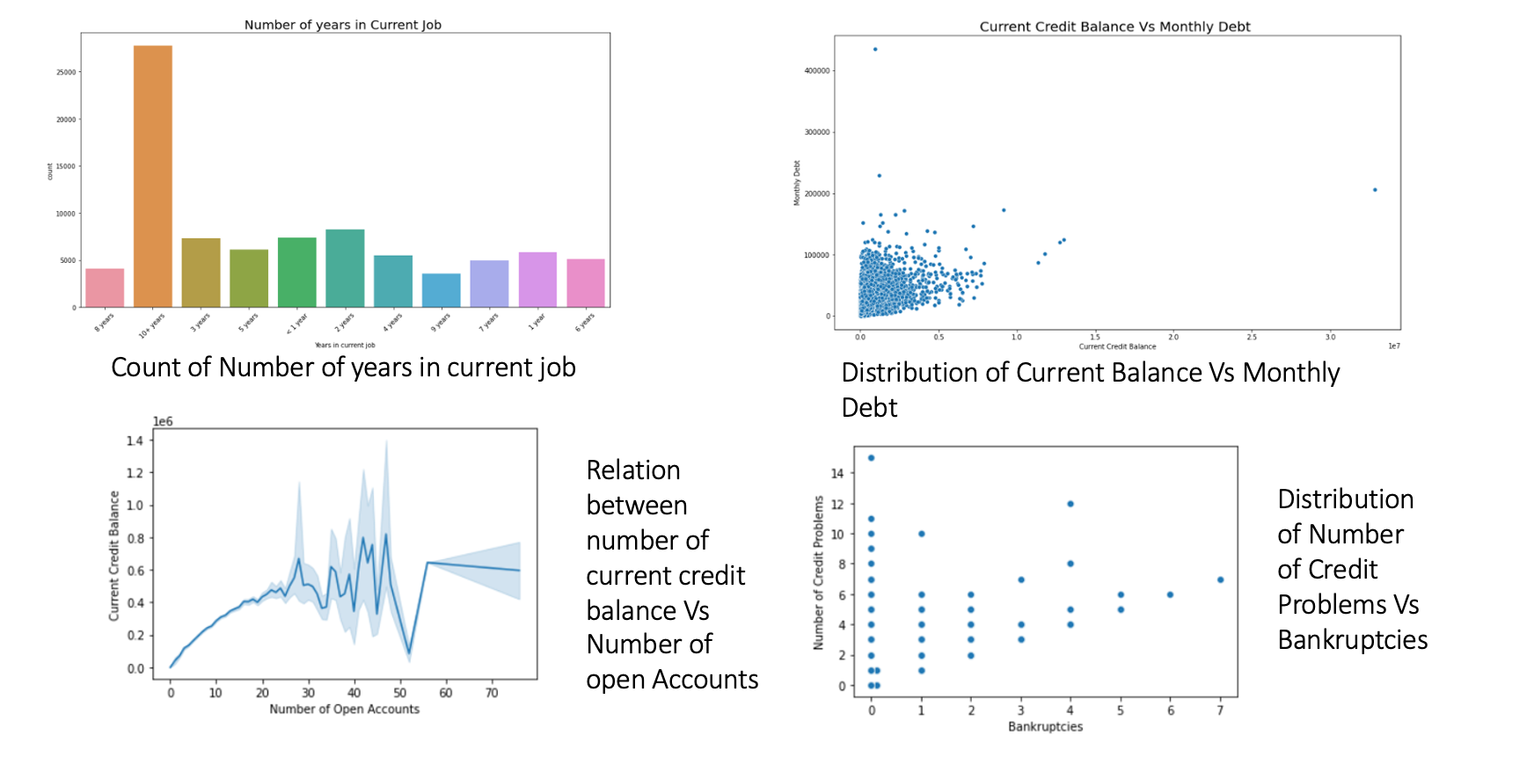
DATA VISUALIZATION

Slide 12
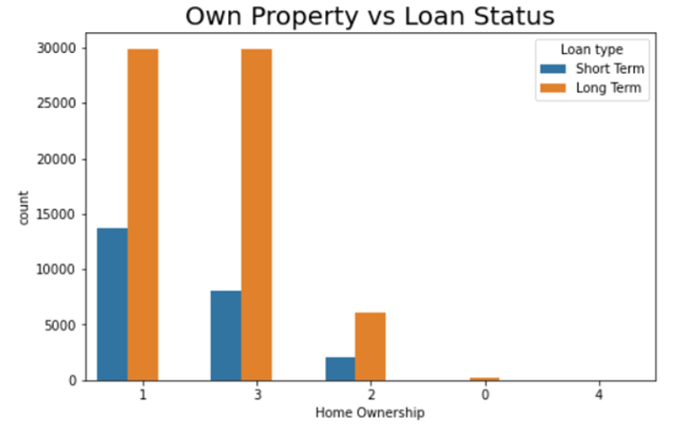
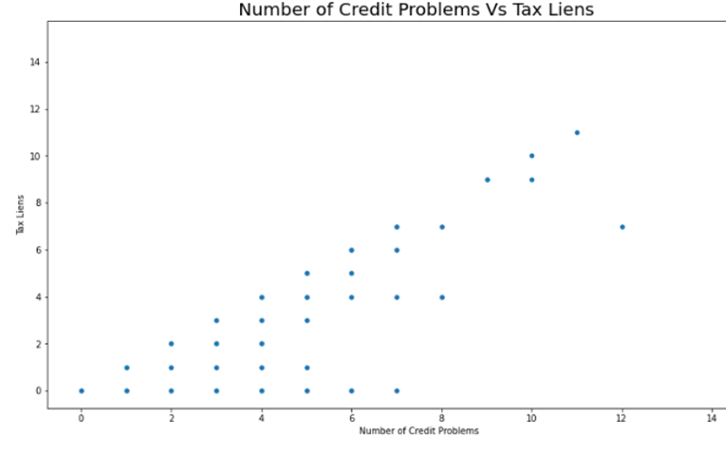
DATA VISUALIZATION
Count of Property depending
upon Home Ownership
Distribution of Credit Problems Vs Tax Liens

Slide 13
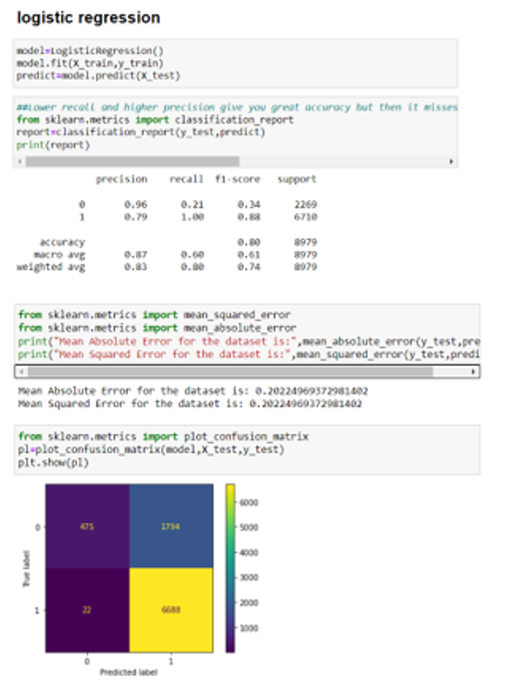
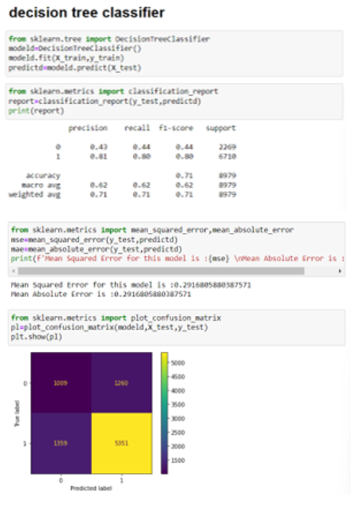
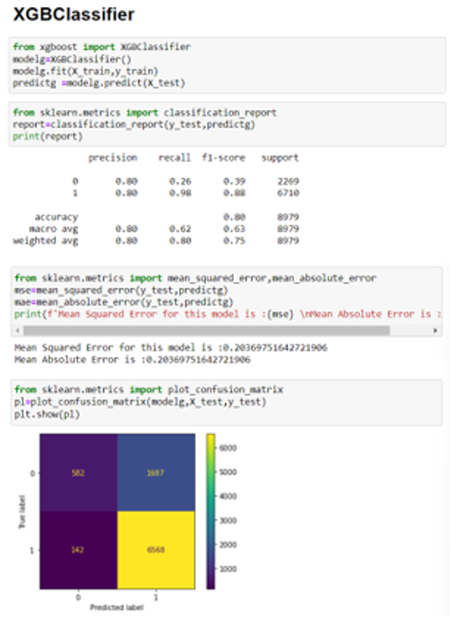
PROPOSED ALGORITHMS/SOLUTIONS

Slide 14

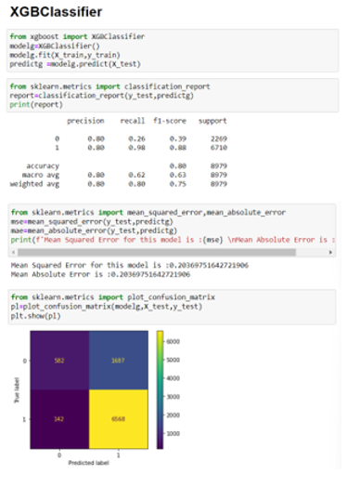
RESULTS OBTAINED/ITS SIGNIFICANCE
The testing of models implied the prediction of loan approval status.
Two models have same accuracy for the given dataset, hence any one of these could be used.

Slide 15

REFERENCES
https://www.kaggle.com/code/rahu7292/ml-from-scratch-with-loan-status-prediction
https://www.kaggle.com/code/muzoonsh/bankloanterm-classification
https://towardsdatascience.com/machine-learning-predicting-bank-loan-defaults-d48bffb9aee2
https://www.kaggle.com/code/palhimanshu/bank-loan-visualization

Slide 16

THANK
YOU!
Group members:
Pankaj 20csu075
Dinesh 20csu191
Jyotroop 20csu207
Tushar 20csu231

